Slide 1
Welcome to Board Day!
• Lunch 11:30 am – 12:30 pm
• Board Meeting starts PROMPTLY at 12:30 pm
WIFI
Network Name: SBC2022
Password: LGCGlobal

Slide 2
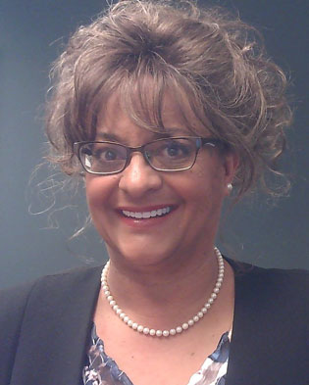

Call to Order

Slide 3

SAME National Business Operations Update
Joe Schroedel, Executive Director

Slide 4
Bottom Line Up Front
FY 2022 Budget Status:
EOY Budget Forecast: -$306k (May ’22 - $700k)
Revenue: -$300k (Dues double counting); -100k (net revenue JETC)
Includes $80k unbudgeted salary adjustments on 1 Oct (retention)
Other Actions:
SBC Tennessee States Sales Tax Relief ($150,000) (secured certificate on 8-4-22)
Reimburse Cash (EMS expenditures) ($200,000 due from reserves on 1 Oct 2022)
Reduce Professional fees (Parted ways with CLA 0n 15 Oct)
Aggressive tracking of SM Dues Restructure Implementation
New financial management system in place (Intacct, Bill.com, Tallie); integrating with Nimble
2021 Audit: Audit Committee met 26 Oct 2022. Clean opinion on financials (8th consecutive year). Some internal controls recommendations.
Finance Team Status: “paddled” vigorously thru the “perfect storm” (lost all staff; CLA issues, new system) – rebuilding in-house team with experienced professionals (Sai Newton Tryer, Beatriz Cook).
AND … we (Society and Foundation) have a brilliant, engaged Treasurer!

Slide 5
Bottom Line Up Front
Enterprise Management System (EMS) Status:
EMS Budget is on track:
$648,990 of $1M expended as of 30 Jun 2022
$941,580 cost to complete (by EOY 2022)
Investment Committee liquidating first $200k of $1M reserve authority ($100k complete)
Go Live date for AMS was 31 August (ended Euclid contract; retained access to data)
Investments:
Summary: Start Value 3QTR YTD End Value
RBC (SAME): $3,036,798 -5.97% -20.31% $2,880,265
Fiducient (SAME): $3,593,872 -6.38% -21.21% $3,273,480
Fiducient (Foundation): $3,152,076 -5.72% -20.01% $2,971,714
3QTR Post Funds Reports sent to Posts – see slide 15 for details
Home Fund activated (Investment Committee) – see slides 16-18
Governance:
2022 XC Strategic Management and Governance Review (7 Aug 2022 at PLW)

Slide 6
SAME LDP Class of 2023 Projects
Bottom Line Up Front:
This year’s LDP Projects are squarely focused on key national efforts that support the Strategic Plan.
Examples:
Camper Recruiting
Foundation Strategic Sustainment Plan
Measuring the Impact of Post Scholarship Programs
Thought Leadership Roadmap (climate change and health services)
Integrating COI efforts to support STEM Pipeline
Enlisted Engagement (supports the TF)
Camp Curriculum Database (SAME impact - tracking campers after camp)
Skilled Trades Outreach (support Construction TF)
Collaboration with USDA; National Security Implications OF Agriculture)
Member Engagement through Mentoring
Transitioning from Technical Go Getter to Managerial Leadership
Speaker’s Bureau (leverage EMS to operationalizing COI’s – attract members)
BUT First … a commercial!!

Slide 7
2021 Audit
Audit Committee Brief: 26 Oct 2022
Taxes: All info with auditor; due 15 Nov
Follow Up Actions:
- All recommendations accomplished or in progress
- Anticipate Personnel Turbulence: Financial Policies and Procedures: document all procedures (step by step desk continuity books)
- Rebuilding Internal Team: (Sai Newton Tryer – Jun 2022; Beatriz Cook – October 2022)
- Parted ways with CLA (June 2021 – October 2022): poor performance
- Due for new auditor: Marcum auditor since

Slide 8
2021 Audit
Internal Controls:
Material Weaknesses:
- Accounts receivable reconciliation: not routinely reconciled
Recommendation: Reconcile monthly and assess collectability
- Credit Card: Will Hoffman’s credit card was used (valid use) 3 months after he departed
Recommendation: Add to exit checklist
- Post Funds: Omaha Post (AP for $20,000) since 2020
Recommendation: reconcile GL accounts with supporting documentation
Significant Deficiency:
- Accounting for Sale of Century House: Settlement charges ($104,000) improperly recorded as
expense versus offset to gain of sale.
Other Matter:
- Unused Bank accounts: Pentagon Federal Credit Union account with no activity
Recommendation: Close unused accounts

Slide 9
EOY Budget Forecast
Society of American Military Engineers
Statement of Activities - Actual vs Budget
For the Eight Months Ended August 31, 2022
 | Month Ended | Month Ended | Month Ended | Month Ended | Month Ended | Month Ended | Month Ended | Month Ended | Month Ended | Month Ended | Month Ended | Month Ended
 | January | February | March | April | May | June | July | August | September | October | November | December
 | Actual | Actual | Actual | Actual | Actual | Actual | Actual | Actual | Projection | Projection | Projection | Projection | Projected Total |  | Projected Total |  | Approved Budget | Variance
 |  |  |  |  |  |  |  |  |  |  |  |  |  |  | (less Investments)
Change In Net Assets
Revenue
Dues | 167,394.96 | 200,662.87 | 146,996.46 | 192,991.44 | 200,785.71 | 191,538.19 | 197,830.86 | 139,883.48 | 203,144.58 | 203,144.58 | 203,144.58 | 203,144.62 | 2,250,662.33 |  | 2,250,662.33 |  | 2,437,735.00 | (187,072.67)
Contributions | 0.00 | 0.00 | 0.00 | 0.00 | 150.00 | 0.00 | 0.00 | 0.00 | 0.00 | 0.00 | 0.00 | 0.00 | 150.00 |  | 150.00 |  | 0.00 | 150.00
Advertising | 54,458.49 | 45,056.56 | 94,973.04 | 2,166.00 | 75,996.82 | 18,333.00 | 57,777.07 | 0.00 | 50,000.00 | 0.00 | 55,000.00 | 0.00 | 453,760.98 |  | 453,760.98 |  | 312,000.00 | 141,760.98
Conference Registrations and Sponsorships | 20,924.00 | 58,112.75 | 369,114.50 | 497.00 | 1,874,812.16 | 78,643.25 | 20,421.00 | 261,862.80 | 57,000.00 | 0.00 | 3,675,000.00 | 0.00 | 6,416,387.46 |  | 6,416,387.46 |  | 6,557,930.00 | (141,542.54)
Other Income | 1,222.06 | 7,024.35 | 15,003.95 | 6,802.23 | 11,569.64 | 5,021.29 | 20,143.95 | 3,209.28 | 3,833.34 | 3,833.34 | 3,833.34 | 3,833.28 | 85,330.05 |  | 85,330.05 |  | 46,000.00 | 39,330.05
Investment Income | (297,795.47) | (161,640.68) | 57,002.04 | (415,863.06) | 18,821.44 | (421,126.06) | 186,361.35 | (226,986.06) | 0.00 | 0.00 | 0.00 | 0.00 | (1,261,226.50) |  | 0.00 |  | 0.00 | 0.00
Grants | 0.00 | 0.00 | 312,500.00 | 0.00 | 0.00 | 0.00 | 0.00 | 0.00 | 5,166.67 | 5,166.67 | 5,166.67 | 5,166.63 | 333,166.64 |  | 333,166.64 |  | 374,500.00 | (41,333.36)
Total Revenue | $ (53,795.96) | $ 149,215.85 | $ 995,589.99 | $ (213,406.39) | $ 2,182,135.77 | $ (127,590.33) | $ 482,534.23 | $ 177,969.50 | $ 319,144.59 | $ 212,144.59 | $ 3,942,144.59 | $ 212,144.53 | 8,278,230.96 |  | 9,539,457.46 |  | 9,728,165.00 | (188,707.54)
Expenditures
Employee-Related Expenses | 254,189.62 | 204,137.85 | 226,789.33 | 244,108.33 | 265,305.44 | 242,325.10 | 234,273.86 | 286,163.47 | 267,070.41 | 273,429.19 | 277,595.86 | 277,595.86 | 3,052,984.32 |  | 3,052,984.32 |  | 3,204,845.00 | (151,860.68)
Professional Fees | 19,407.33 | 33,369.20 | 7,750.89 | 70,540.43 | 63,585.89 | 45,138.50 | 29,017.50 | 25,302.60 | 22,458.33 | 27,958.33 | 33,458.33 | 33,458.33 | 411,445.66 |  | 411,445.66 |  | 269,500.00 | 141,945.66
Meeting Expenses | 1,073.48 | 6,634.69 | 60,166.82 | 171,210.11 | 1,205,178.89 | 192,579.62 | (33,177.53) | 142,087.01 | 0.00 | 0.00 | 2,600,000.00 | 0.00 | 4,345,753.09 |  | 4,345,753.09 |  | 4,132,865.00 | 212,888.09
Other Expenses | 104,698.17 | 161,227.60 | 138,214.00 | 165,400.88 | 263,860.12 | 169,146.01 | 112,977.27 | 98,909.17 | 162,431.07 | 162,431.07 | 162,431.07 | 162,431.25 | 1,864,157.68 |  | 1,864,157.68 |  | 1,949,173.00 | (85,015.32)
Total Expenditures | $ 379,368.60 | $ 405,369.34 | $ 432,921.04 | $ 651,259.75 | $ 1,797,930.34 | $ 649,189.23 | $ 343,091.10 | $ 552,462.25 | $ 451,959.81 | $ 463,818.59 | $ 3,073,485.26 | $ 473,485.44 | 9,674,340.75 |  | 9,674,340.75 |  | 9,556,383.00 | 117,957.75
Total Change In Net Assets | $ (433,164.56) | $ (256,153.49) | $ 562,668.95 | $ (864,666.14) | $ 384,205.43 | $ (776,779.56) | $ 139,443.13 | $ (374,492.75) | $ (132,815.22) | $ (251,674.00) | $ 868,659.33 | $ (261,340.91) | (1,396,109.79) |  | (134,883.29) |  | 171,782.00 | (306,665.29)

Slide 10
Cash Flow Forecast
As of 10/18/22
Checking Account Balance 1,172,477.45
MM Account Balance (Less Home Sale Proceeds) 747,793.76
Available Cash Balance 1,920,271.21
Less AP:
Bill.com Payables (in progress) (149,484.00)
Total AP (149,484.00)
Less Payroll & 401K:
10/31/22 401K Contributions (12,300.00)
10/31/22 Net Payroll Plus Salary Adj (91,359.00)
Total Payroll (103,659.00)
Available Cash Balance as of 10/18/22 1,667,128.21
Available Cash Balance as of 10/18/22 (Less MM) 919,334.45
NOTES:
Home Fund:
$2,070,000 Transferred to RBC for investment
SBC Catering Deposit: $1M (asked for $1.6M)

Slide 11
EMS
Financial Status:
Item $ | Paid 2021 | Paid 2022 | Forecast Due 2022 | Totals | Notes
EMS Consultant (Wes Trochlil) | $118,750 | $0 | $0 | $118,750 | Fully paid
AMS (NimbleUser) | $245,552 | $107,038 | $205,590 | $558,180 | Incl Lic thru Mar’24
CMS (Results Direct) | $85,500 | $73,500 | $65,000 | $224,000 | Incl Lic thru Mar’24
Application Software (Open Water) | $18,650 | $0 | $22,000 | 40,650 | Incl Lic thru Jul ‘23
FMS |  |  |  |  | Lic fees paid (op funds)
 | $468,452 | $180,538 | $292,590 | $941,580
Notes:
AMS: Staff Training 11,12 Aug; Go Live was 31 Aug; next major milestone is 1 Dec 2022 - IOC (initial operational capability); FOC by 1 July 2023
CMS: Results Direct delivered website framework on 31 August; In-House web page development thru March 2023
FMS: Intacct, Bill.com (invoice) and Tallie (expense) all operational; full integration with Nimble, eShow, etc in 2023

Slide 12
Dues Restructuring Initiative
Dues Restructuring Initiative:
Approved by the BOD: June 2021
Individual Member (IM) Implementation: 1 Jan 2022 (no issues)
Sustaining Member (SM) Implementation: 1 July 2022 thru 30 June 2023
- 1500 SMs; 85% small companies
- Annual turnover experience: drop 200 and add 200
- Tracking Monthly forecast of impact (members and revenue) vs actual
- Robust and personal engagement with SMs (telephonic, webinar, etc.)
Summary:
- SAME Brand is strong – external forces (market, social, etc.) having little impact (so far) on membership renewal
- Dues Restructuring Initiative facilitated EMS development (member management - one record for every member)
- Detailed tracking will provide opportunity to develop trends and forecast ultimate impact
- All members have a 60-day grace period to renew before they are dropped.
- SM Renewal percentage (68%) for time period is typical

Slide 13
SM Renewals Schedule July - Aug
Month -> | July |  |  |  |  | Aug
# Empl | Total Potential |  | OLD dues | Actual |  | Total Potential |  | OLD dues | Actual
 | Qty | 100% $$ |  | Renew # | Renew $ | Qty | 100% $$ |  | Renew # | Renew $
1-10 | 31 | $13,140 | $9,605 | 22 | $9,225 | 40 | $15,810 | $12,655 | 19 | $7,255
11-50 | 36 | $28,295 | $24,045 | 31 | $23,730 | 52 | $43,605 | $34,750 | 26 | $22,710
51-100 | 15 | $22,755 | 17,880 | 6 | $15,575 | 15 | $21,365 | $15,615 | 11 | $13,350
101-500 | 17 | $33,960 | $24,560 | 15 | $22,560 | 29 | $70,131 | $48,800 | 14 | $28,115
501-1,000 | 6 | $11,900 | $9,140 | 4 | $8,710 | 9 | $29,565 | $19,590 | 6 | 20,890
1001-5,000 | 2 | $7,010 | $3,600 | 1 | $2,920 | 4 | $13,825 | $7,450 | 3 | $4,700
5,001 + | 3 | $31,365 | $20,780 | 3 | $28,675 | 1 | $23,685 | $11,030 | 1 | 21,680
Total # | 110 | $148,425 | $109,610 | 82 | $111,395 | 150 | $217,986 | $149,890 | 80 | $118,700
All companies with August, September renewal dates were invoiced from Nimble the week of October 3, so August renewals are still coming in.
34 new companies have joined since September 1.
As of 10/04/2022

Slide 14
SM Renewal Schedule Sept - Oct
Month -> | September |  |  |  |  | October
# Empl | Total Potential |  | OLD dues | Actual 10-20-2022 |  | Total Potential |  | OLD dues | Actual
 | Qty | 100% $$ |  | Renew # | Renew $ | Qty | 100% $$ |  | Renew # | Renew $
1-10 | 24 | $8,040 | $7,800 | 11 | $4,010 | 28 | $9,500 | $8,300
11-50 | 39 | $29,745 | $23,745 | 17 | $12,900 | 35 | $27,845 | $27,095
51-100 | 17 | $18,295 | $15,735 | 6 | $7,365 | 18 | $23,860 | $17,270
101-500 | 20 | $25,640 | $21,450 | 9 | $13,255 | 15 | $30,295 | $23,640
501-1,000 | 2 | $2,685 | $2,160 | 1 | $1,450 | 4 | $17,490 | $13,420
1001-5,000 | 4 | $26,315 | $12,570 | 3 | $18,055 | 7 | $39,490 | $19,910
5,001 + | 5 | $29,835 | $18,270 | 3 | $8,305 | 1 | $34,705 | $14,460
Total # | 111 | $140,555 | $103,335 | 50 | $65,340 | 108 | $183,185 | $125,095
All companies with August & September renewal dates were invoiced from Nimble the week of October 3, so September renewals are still coming in and are not technically late since they were not billed on time.
34 new companies have joined since September 1.
As of 10-20-2022

Slide 15
SM Renewal Schedule Nov - Dec
Month -> | November |  |  |  |  | December
# Empl | Total Potential |  | OLD dues | Actual |  | Total Potential |  | OLD dues | Actual
 | Qty | 100% $$ |  | Renew # | Renew $ | Qty | 100% $$ |  | Renew # | Renew $
1-10 | 34 | $11,705 | $10,250 |  |  | 23 | $7,970 | $6,925
11-50 | 38 | $32,865 | $30,195 |  |  | 53 | $42,030 | $38,225
51-100 | 13 | $31,585 | $24,420 |  |  | 13 | $18,825 | $15,090
101-500 | 12 | $20,240 | $13,815 |  |  | 26 | $57,015 | $43,710
501-1,000 | 3 | $11,585 | $7,490 |  |  | 7 | $20,050 | $14,470
1001-5,000 | 6 | $69,520 | $34,630 |  |  | 11 | $61,545 | $39,230
5,001 + | 3 | $12,850 | $9,720 |  |  | 3 | $21,615 | $17,000
Total # | 109 | $190,350 | $130,520 |  |  | 136 | $229,050 | $174,650
As of 07/07/2022

Slide 16
SM Renewal Schedule TOTALS
 | July |  | Aug |  | Sept |  | October |  | November |  | December
 | Predict | Actual | Predict | Actual | Predict | Actual | Predict | Actual | Predict | Actual | Predict | Actual
1-10 | $11,169 |  | $12,095 |  | $7,236 |  | $8,550 |  | $11,000 |  | $7,500
11-50 | $24,051 |  | $33,358 |  | $25,283 |  | $27,500 |  | $30,000 |  | $35,726
51-100 | $19,342 |  | $16,344 |  | $15,551 |  | $20,281 |  | $26,847 |  | $16,001
101-500 | $28,866 |  | $53,650 |  | $21,794 |  | $25,751 |  | $17,204 |  | $48,463
501-1,000 | $10,115 |  | $22,617 |  | $2,400 |  | $14,867 |  | $9,000 |  | $17,000
1001-5,000 | $5,959 |  | $10,576 |  | $14,000 |  | $26,000 |  | $44,000 |  | $47,082
5,001 + | $26,660 |  | $18,119 |  | $18,300 |  | $18,000 |  | $10,000 |  | $19,500
Total $ | $126,161 |  | $166,759 |  | $104,564 |  | $140,948 |  | $148,051 |  | $191,271
 | Qty All Companies | 100% of new dues | Total Prediction | Actuals
July – December | 724 | $1,109,551 | $890,583
As of 07/11/2022

Slide 17
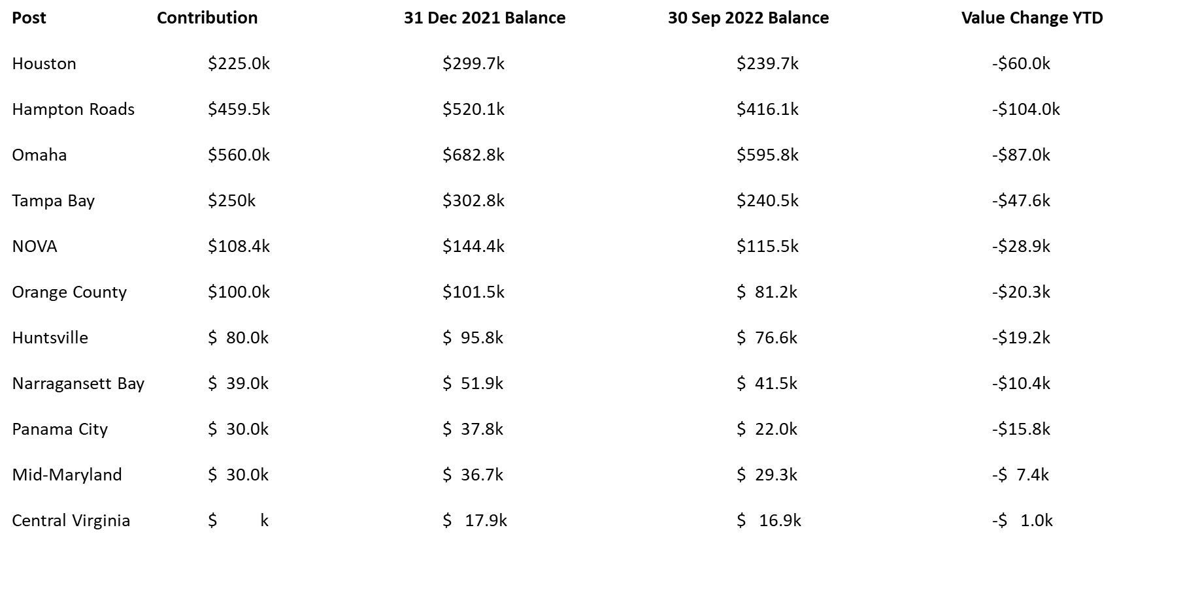
Post Funds Status

Slide 18
Home Fund
SAME Home Fund Objectives:
Growth
Produce income
Protect principle
SAME Home Fund Allocation:
40% Stocks
30% Alternatives
30% Bonds
Dollar Cost Averaging Approach:
Plan to invest in equal amounts over the next 12 months with the option to accelerate depending on market conditions.
Income Objective:
Focus on income producing securities to reach an income goal of 2.5%
NOTES:
Principle: $2,070,000
Investment Committee revised IPG for Home Fund
RBC Wealth Mgt (one of our two investment companies) chosen to manage Home Fund.
RBC will reinvest income unless we request withdrawal.

Slide 19
SAME Home Fund Investment Policy Guidance
Home Fund Purpose: Funds targeted to be used for supporting acquisition, sustainment, and operation of physical facilities for the SAME National Office.
Operating Fund Purpose: SAME's primary investment objectives for its operating reserves funds are to preserve the financial stability of the association, protect its assets, and provide supplemental cash to meet the needs of SAME’s general operations.
Objectives
  Moderate 2.5% annual return target or better
  2.5% annual dividend that may be reinvested if not needed for operation
  Purchasing power preservation
  Long-term capital growth
  Maximize returns in keeping with other objectives

Slide 20
SAME Home Fund Investment Policy Guidance
Risk Mitigation
  Low return target
  Known Investment Advisor (RBC)
  Target allocations
  Dollar-cost averaging approach to investing the $2,070,000.00
Asset Class | Target | Minimum |  | Maximum
Equity | 40% | 25% | to | 55%
Alternatives | 30% | 15% | to | 45%
Fixed Income | 30% | 15% | to | 45%
Cash & Equivalents | 0% | 0% | to | 10%

Slide 21
SAME National Governance & Management
As of 5-2-22
President
Board of Direction
Chaired by President
Executive Director
Governance
Management: National Office Ldrshp
Management: National Office Staff
SAME National Office Staff
Guidance/Execution
Executive Committee
Chaired by President
Foundation
Affiliate Relationship
Direct Relationship
National Officers:
Past President
President Elect
3 x Vice Presidents
Awards & Recognition
National Officer
(AOF Chair)
National Officer (IGE)
National Officer
(Human Capital)
National Officer (RVPs)
Past President
Foundation
Academy of Fellows
Membership COI
Investment Committee
Communities
(governed by
Steering Committees &
extensions of the National Office)
Communities
(governed by
Steering Committees &
extensions of the National Office)
RVPs
Posts

Slide 22

SAME National Governance & Management
OUTCOME:
Change WHEN we DEFINE and FIND …
the RIGHT next XD.
HOW?
GREAT
OPPORTUNITY
This Photo by Unknown Author is licensed under CC BY-SA

Slide 23
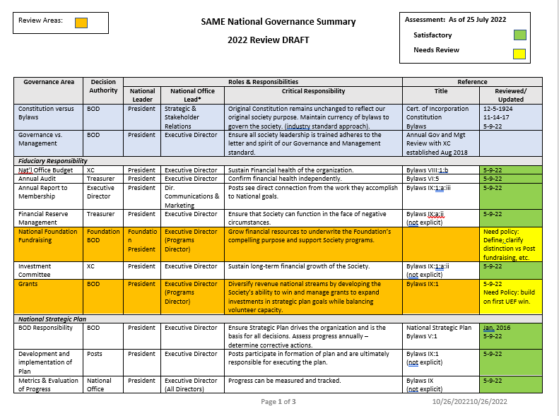
SAME National Governance & Management
2022 Annual Review

Slide 24
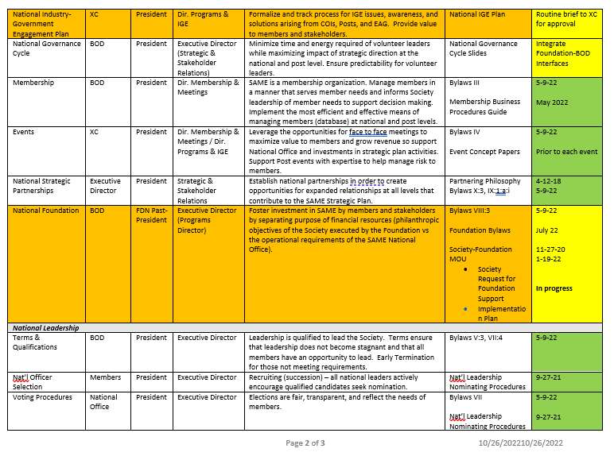
SAME National Governance & Management
2022 Annual Review

Slide 25
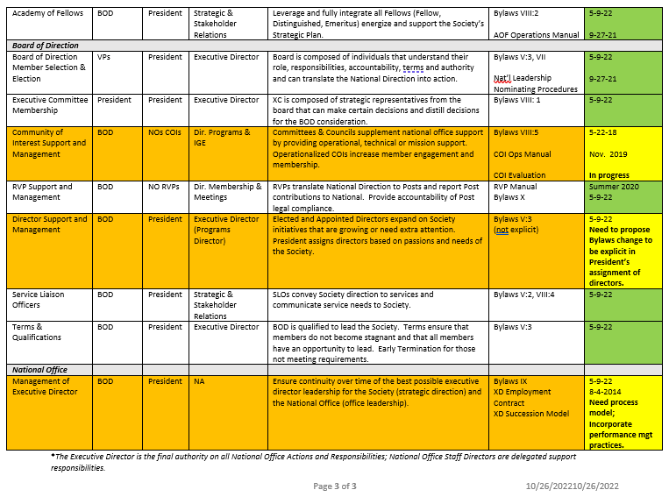
SAME National Governance & Management
2022 Annual Review
Succession (Model)
- Bylaws
- Employment Contract
- Position Description (basis)
-- Strategic Direction Review
- Performance Mgt
Selection
- Search Committee (option)
Transition (continuity)
- Seamless handoff

Slide 26
XD Succession Timeline
September:
22 Sept: Establish Succession Team: (Schroedel, Nash, Lincicome, Parham, Biedermann) Kathy Off support
22 Sept: Inform Foundation Chair, National Office SLT, NLT
October:
Draft XD Succession Model (Schroedel)
Begin Drafting Strategic Direction Review (Schroedel)
5 Oct: inform XC
11 Oct: discuss drafts with staff (All Hands Day)
By 31 Oct: establish Succession Team Comms plan (in progress)

Slide 27
XD Succession Timeline
November:
SBC: Inform BOD, Foundation Board
Succession Team Meeting at SBC (discuss progress on drafts)
RADM Nash takes Foundation Chair; sets plan for January strategic meeting; XD briefs succession timeline to
Foundation Board at SBC and solicits input to draft process and strategic review
Begin Bylaws Subcommittee review of nonvoting board members (treat each individually, not as group)
January:
Foundation Strategy Meeting
Drafts (Succession Process and Strategic Direction review) to NLT and XC
(T) Spring 2023: Find right new XD
Selection Team activated (Lincicome, Parham, Nash)
(T) Spring, Summer 2023: XD Transition and hand off

Slide 28
XD Succession: Strategic Direction Example
Strategic Direction Line of Effort: Society Governance
Opportunity: BOD is too big … BUT … representative nature adds value
Only some are elected … few members vote … tough sledding employing talents of Elected Directors
Imagine (potential direction):
Current BOD becomes an Advisory Board (64 members)
XC becomes the BOD (17 members) – already governs business operations
- create new selection process for new BOD – select from Advisory Board
- Elected Directors – Mike Hufstettler initiative
Nonvoting Member issue: “Reaffirm nonvoting members every three years (Counsel, Treasurer, XD)” - inadequate
- Treasurer should be voting member?
- Counsel – unique role – succession should be handled carefully
- XD – senior executive; paid employee; answers to BOD

Slide 29
Summary
We are financially healthy.
We are delivering value.
We are growing – and have even greater potential.
We are professionally governed and managed by dedicated volunteer leaders and a great full-time staff.
We are the “SAME family”.
Deeds Not Words!
Schroedel (2014 – 202x)

Slide 30

SAME Foundation Update
Mark Handley, Past President & Foundation Liaison

Slide 31
Foundation/Society Update
  Foundation Bylaws Update– Consent Agenda
    Highlights (details in read ahead)-
      Established “Chair Elect”
      Established Executive Committee
      Allow Directors re-selection after second term (w/ 1 year gap)
      Officers to be elected or appointed by Foundation Board Chair
      President term changed from 3 years to 2 years
      Various editorial clean up changes
  New Foundation Board Members
    Strong Nominations – key to longevity of the Foundation
    Expect to fill 5 vacancies
    Nominations approved by the Foundation Board have been submitted for appointment by the Executive Committee of the Society’s Board of Direction.

Slide 32
Foundation/Society Update
Society Funding Request
  Input from COIs and RVPs continues to mature
  Ranking and Review Committee (R2C) held 12 Oct
    Requests to maintain currently supported programs (LDP, Camps, etc.)
    SAME Executive Committee to review alongside Budget review (30 Nov 2022)
    President submits to Foundation (Dec 2022)
2023 Process Highlights
  COI Workplans need to include resource requests (Due EOM June 2023)
  RVPs need to submit resource requests (Due EOM June 2023)
    Resource requests need to be aligned to Strategic Plan
    Best if they have high visibility (Help the Foundation help us)

Slide 33
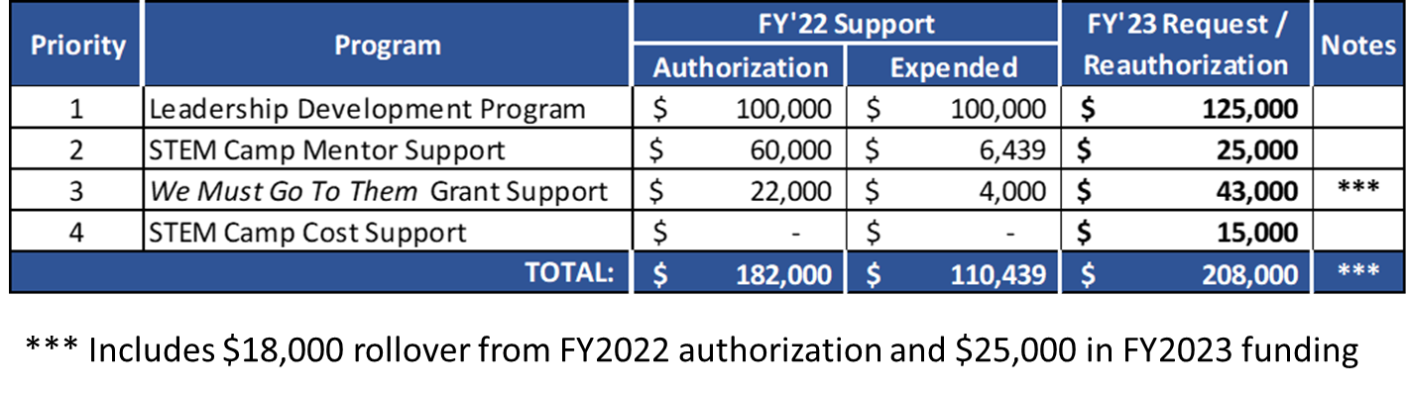
Foundation FY23 Funding Request – Summary

Slide 34
Service Member Task Force
Dave Newkirk, Elected Director

Slide 35
SMTF Timeline
May 2022 – Service Member Task Force (SMTF) established by Cindy Lincicome.
  Focus on how we can provide greater value to our members.
Jun – Sep 2022 – SMTF built, conducts meetings to develop recommendations.
  Survey done in June 2021 determined that most uniformed members are aware of the value.
  Bigger issue is lack of uniformed members.
  Expanded mission with President approval to explore the issue.
Oct 2022 – SMTF briefs XC on proposals for BOD. XC provided feedback:
  Define the problem better.
  Consider separate Service Member COI.
  Coordinate with Membership COI Chair.
Oct - Nov 2022 – SMTF addresses XC feedback.
  Collected data from membership and uniformed services (Army, Navy, Air Force to start) to help define the problem.
  Separate COI was considered, but determined too early in the process to stand alone. First need to address membership, create benchmarks, develop focus groups with outside influence as opposed to doing the same thing with the same few people that has been done before.
  Membership & Enlisted COI Chairs support the proposal and agree with a uniformed co-chair.
Nov 2022 – SMTF presents decision brief to BOD.

Slide 36
Where Have They Gone?
SAME is a membership organization.
Individuals CHOOSE to become members.
Organizations CHOOSE who they serve.
Is this acceptable?
Less than 5%
SAME members CHOOSE
to serve uniformed engineers.
Notes:
Current membership numbers by service (started with big 3)
US Army : 90,000 officer and enlisted engineers (790 members) = 1%
US Navy: 12,300 officers and enlisted engineers (455 members) = 4%
US Air Force: 30,400 officers and enlisted engineers (883 members) = 3%
Currently, 12% of our total membership is uniformed.

Slide 37

Uniformed Member Recruiting is the Issue
Our Future
Our Past and Present
OUTCOME: uniformed engineers choose to belong to SAME.
Service Engineering Chiefs served as the SAME National President (92 years).
2012: Chiefs no longer allowed to serve as National President – now “liaisons”.
Military commanders used to direct membership in SAME.
Uniformed membership in SAME has been declining over time.
SAME “uniformed” efforts have had little impact on the trend.
44,000 other organizations exist to “serve” uniformed members – competition for members.
RECRUITING
“Build it and they will come.”
Vs.
“Bring them with you.”
Notes:
Current membership numbers by service (started with big 3)
US Army : 90,000 officer and enlisted engineers (790 members) = 1%
US Navy: 12,300 officers and enlisted engineers (455 members) = 4%
US Air Force: 30,400 officers and enlisted engineers (883 members) = 3%
Currently, 12% of our total membership is uniformed.

Slide 38
Organizing to Solve the Right Problem
National Leadership
NonMembers
Unengaged Members
SLOs
Recommendations
Membership COI Task
Membership COI
External Input
Establish Service member Work Group
Establish uniformed co-chair for Membership COI as outward-facing message and to alleviate workload of current chair.
Unify existing efforts:
  Transfer Enlisted COI to fall under SMWG as a sub-committee
  Other sub committees are suggested
Membership COI can address civilian government population separately.
Non-Uniformed Member Co-Chair
Uniformed Member Co-Chair
Recommendations
????
Service Member Work Group
Transition Committee
Enlisted Committee
Engagement Committee
Notes:
Absolutely need UNIFORMED leadership – cannot fall under an industry person.

Slide 39
Understanding the Journey
Establish Service Member Working Group under Membership COI.
Task #2: Understand why past SAME efforts have been ineffective at recruiting.
Task #1: Understand the target population (how do they choose to spend their discretionary time? Etc.)
Next Steps for SMWG
Out of the box solutions?
Chiefs Support?
It’s a long-term journey!
Notes:
This will be a journey that absolutely needs to start with membership…

Slide 40
Sustaining Momentum
Suggested Secondary tasks
Develop appropriate member communications to be sent in ways and at times that support uniformed service op-tempo.
Manage and leverage existing Strategic Partnerships to enhance SAME support to uniformed servicemembers.
Leverage Service Liaison Officers (SLOs) to assist with awareness and dissemination of value proposition to non-members.
Transition Committee.
  Help create and maintain (with SAME Staff assistance) the “transition web page.”
  Maintain Transition Mentor database to include testimonies from previous transitioning servicemembers.
  Assist Posts with local partnerships.
  Act as advisors for Career Transition Workshop (manage expectations).
  Create and maintain Post sponsorship program for PCSing and ETSing service members.
Enlisted Committee.
  Continue initiatives currently underway.
  Advise Workgroup and Membership COI about the unique situations and issues that enlisted personnel face.
  Leverage officer assistance in obtaining leadership buy-in to participation.
Engagement Committee.
  Track/measure membership numbers across all uniformed services (8 total).
  Identify barriers to participation in SAME entities (COIs, Posts, National Board, AOF, LDP).
  Track/measure engagement using new EMS.
  Leverage IGE Program to engage appropriate uniformed services.
Notes:
This is not an all-inclusive list.

Slide 41
BOD Enabling Decisions
Appoint Uniformed member to serve as Membership COI Co-Chair.
  Recommend Brad Wilson as first Co-Chair.
  Could potentially be enlisted, then officer (switch off according to terms). Rank is not relevant to SAME position – appointed by President.
Create a Servicemember Work Group (SMWG) under Membership COI to unify existing efforts.
Transfer Enlisted COI to fall under SMWG as a sub-committee.
This is only the beginning … the ultimate outcome is …
uniformed engineers choose to belong to SAME.
Notes:
Even though the chair could switch off between enlisted and officer, we do not feel that they should be separate as they will achieve more through close collaboration. The SMTF feels that all three positive decisions will be a step in the right direction.

Slide 42
Construction Task Force
Mike Wehr, Task Force Chair

Slide 43
Construction Task Force Update
Authority: SAME’s 2022-2023 President, Cindy Lincicome, directed the establishment of a Construction Task Force to examine the need for, and feasibility and potential impact of establishing a Construction COI. MG Mike Wehr, USA (RET) was asked and accepted the Chair of this important effort and formed a team.

Slide 44
Construction Task Force Update
Purpose: Confirm or Deny the need for a Construction COI by forming an inclusive TF for diversity of thought, enabled by enough leadership to deliver timely recommendations that make progress on addressing today’s challenges in the Construction Industry as mentioned in the article Challenges the Construction Industry is Facing in 2022, AssuredPartners, 24 Feb 2022: (https://www.assuredpartners.com/blog/detail/bid/683/construction/challenges-the-construction-industry-is-facing-in-2022)
  Qualified worker shortage
  Supply chain disruption and material sourcing issues
  Inflation
  Others, like Alternate Contract Delivery methods, DOL Proposed Davis Bacon Act Revisions, PLA Mandates impacting costs, labor pressures stifling small business growth, Buy America Act changes could exacerbate existing supply chain issues.

Slide 45
Construction Task Force Update
Initial TF Membership:
  Mike Wehr, Atkins Defense Sector Manager, Large Business
  Patrice Melançon, Consultant, Large Business
  Thad Tobaben, Kiewit Foundations, Business Development, Large Business
  Ben Nichols, Harkins Builders, Medium/Large Business
  Kevin Wimsatt, CEO, Bold Concepts, Small Business
  LTC Craig Bryant, USACE, Tulsa District Deputy Commander
  Mario Burgos, President & CEO at Burgos Group, LLC, Small Business
  Angie Martinez, VP Business Development at Martinez Construction Services, Small Business
  Curt Haldeman, Regional VP, Federal Division at Granite Construction, Large Business
  Rob Biedermann (SAME Direct Support, along with Jeanne LeBron & Merle Keener)
  To be confirmed: Mercedes Enrique, CMS, Corp.
  To be confirmed: CAPT (R) Julius C. "Jake" Washington, Jacobs, large business

Slide 46
Construction Task Force Update
Potential Advisory Group Participation:
  Associated General Contractors of America (AGC): Jordan Howard
  American Council of Engineering Companies (ACEC)
  Construction Management Association of America (CMAA)
  National Academy Of Construction (NAC)
  USACE
  NAVFAC
  AFCEC
  Others? … Associated Building Contractors (ABC), Building Congress & Exchange, American Subcontractors Association, Design Build Institute of America (DBIA)?

Slide 47
Construction Task Force Update – Way Ahead
Task | Timeframe
Brief to SAME Board of Direction (BoD) | November 1, 2022
Brief SAME Executive Advisory Group (EAG) | November 3, 2022
Gather inaugural Construction TF for initial guidance (at SBC) | SBC 2022
Finalize additional 2-3 TF members | November 4, 2022
Conduct Survey to inform focus areas | November – December, 2022
Initiate routine bi-weekly TF Action/Guidance tracking | December, 2022
Make recommendation to BOD | JETC 2023

Slide 48
IGE Update
Rob Biedermann, SAME Programs & IGE Director

Slide 49
IGE Update: Agenda
  Current Project Update
  Pending Pressing Issues
  EAG Topics

Slide 50
IGE Update: Current Projects
Ongoing: 9
Completed: 1
Pending Legislation/rules: 3

Slide 51
IGE Update: Project Highlights
  SDVOSB Certification: New certification process scheduled to go live 1/1/23
  TORN: DRAFT FY'23 NDAA language prohibits any agency from routinely requesting supplemental information
  Project Partnering: DoD implementing pilot program
  Small Business Size Standards: Ramp Up Act submitted as amendment to Senate FY’23 NDAA

Slide 52
IGE Update: Project Highlights – EAG Briefs
  Alternative Delivery Methods: Possible rescope including NAVFAC Early Contractor Involvement Pressing Issue
  CPARS Reform: Presenting findings and three recommendations
  PFAS Information: Requesting wider dissemination
  Cybersecurity in the Built Environment: Update

Slide 53
IGE Update: Pressing Issues
Received five new Pressing Issues for consideration:
  Student Chapter Membership Challenge: Appears internal to SAME, refer to College Outreach COI and resubmit…
  STEM Development: Refer to K12 STEM Outreach COI for review and endorsement…
  PFAS Insitu Solution: Refer to Environmental COI for review and endorsement

Slide 54
IGE Update: EAG Topics
SAME Update
IGE Task Force Report
Current Project Updates
Pressing Issue Review
Construction Task Force Discussion

Slide 55

AOF Update
Rad Delaney, Vice President/AOF Chair

Slide 56
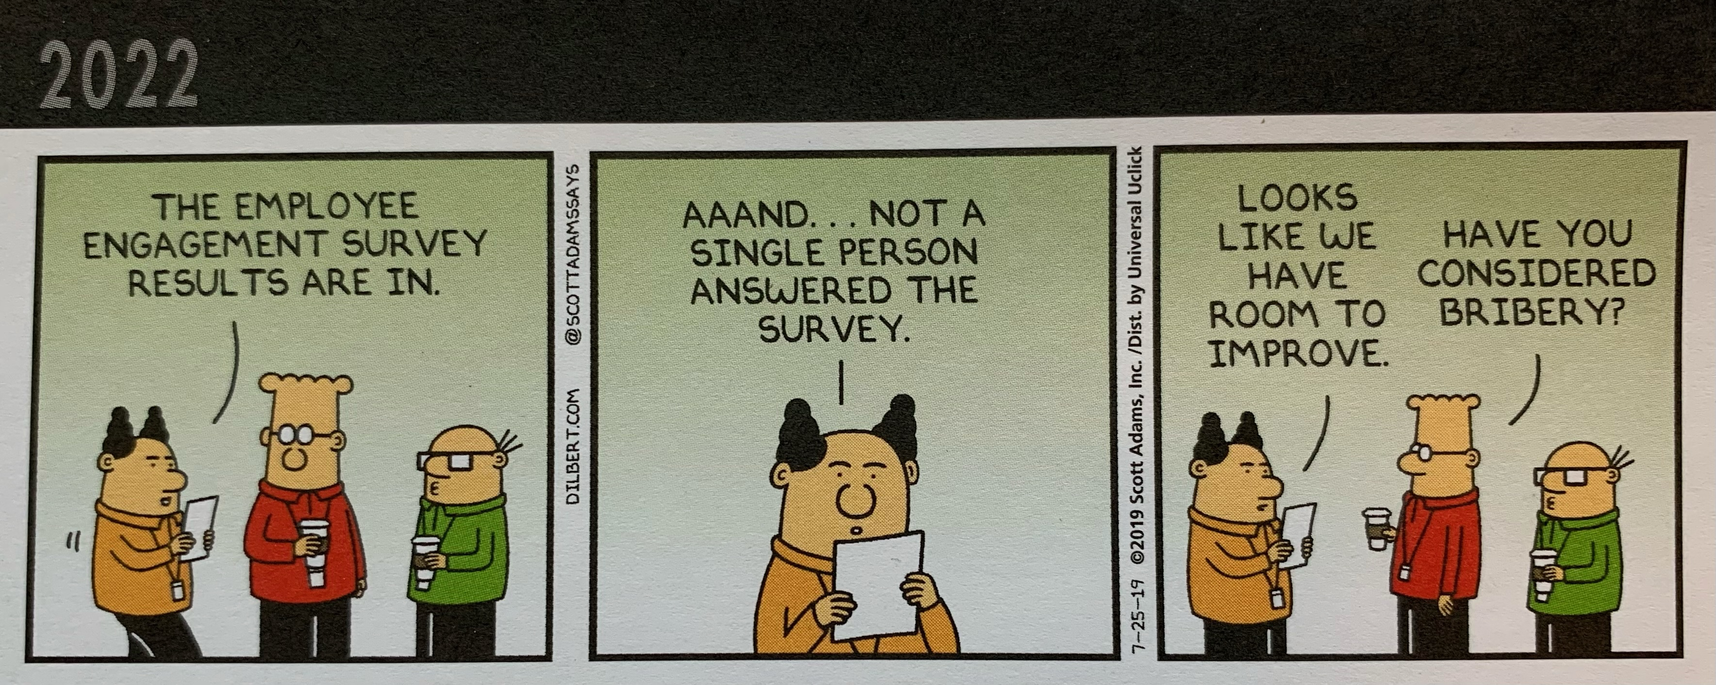
2022 AOF Engagement Survey
Conducted Via email
Sent to all Fellows in good standing using current email contact information.
  Over 800 emails sent to 748 Fellows
  Many Fellows have multiple records
Looking for recent engagement (at this time and date)
422 Fellows responded, 17 found to be deceased
23 Fellows from classes of 2018-2022 did not answer the survey
56% of Fellows are engaged at the most basic level.
Notes:
Emails were sent from the database first, then two follow-ups directly from Kathy Off’s email. Bouncebacks were tracked and handed on to RFPOCs to follow-up.
The fact that 23 people who are newly invested in last 5 years did not respond to the survey is concerning. However, overall, we had an EXCELLENT response.

Slide 57

Why did we do this?
Allows for a clean-up of data before switching to new EMS
Gives a more accurate picture of the number of Fellows
Provides a benchmark for future trends and improvements
Fellows are heard and concerns are addressed
Some Post Fellows making personal calls and catching up with long-time members – finding some interesting stories!
The majority of Fellows fall into four categories:
  Those who answered the survey and are engaged in some way
  Those who answered the survey and cannot be engaged for personal reasons, age, or retirement status
  Those who did not answer the survey because they are not getting emails from SAME (firewalls, or not keeping up profile)
  Those who chose not to answer the survey – some of whom we know are engaged
Notes:
Those who chose not to answer the survey are really the issue when talking about engagement of Fellows. Most Fellows ARE engaged or past the ability to be so.

Slide 58
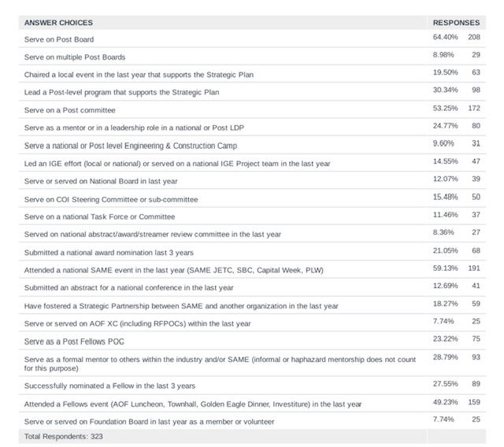

Types of involvement
323 answered 99 skipped
*One to add for next iteration: TME Article or contributor.

Slide 59
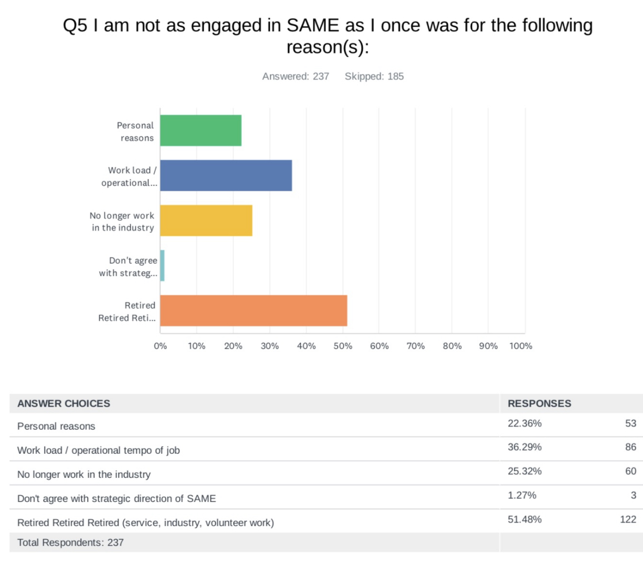
Not as engaged in SAME as once was (reasons)
Some other examples of why not engaged
Post doesn’t reach out
Distance from nearest Post
TME and other newsletters suffice in staying up to date
No local in-person meetings
No mentoring meetings held/Not able to mentor online
Time and allowance for younger members to step up
Too costly for travel and attendance as a retiree
Post leadership issues

Slide 60
What can leadership do to bring back (if not as engaged)
144 answered 278 skipped
Assist recruiting new Post Members
Post doesn’t reach out to senior members
Provide easy to find opportunities to engage with limited time commitment
Impact of personal costs
Be open to new ideas at National level
Work on getting industry and military leaders supporting SAME
Make events with virtual capability
Most answers refer back to age and retirement status. At this point in their lives, they do not plan to get MORE engaged with SAME.

Slide 61

What else should SAME Leadership know about Fellows Engagement? (some excerpts)
Post level engagement to keep them going locally
Informal, haphazard, selective mentorship is valuable at local posts
Many fellows are active at many posts
Emphasize the fun and fulfilling aspects of SAME
Advertise/recruit for Fellow opportunities/involvement/engagement
Ensure Post Fellow POC and Regional Fellow POC are engaged
Value the existing Fellows more at Posts
LinkedIn page for Fellows
Share results of engagement survey and revisit
Share engagement success stories, methodologies
Challenge the Fellows to hold post and national support roles, donate, recruit, and adhere to AoF charge
Be realistic about term of AoF engagement (don’t expect support forever)
Stay on track

Slide 62
What else are we doing?
Continuing to Serve (Recognition of continued service) – Jeanne LeBron
  Re-energizing the Japan Post – Eric Warner
  Mid-MD Small Business Forum – Philios Angelides, Susan Merrigan, Bill Haight
  JB Andrews Mentoring Workshop – Philios, James Koch, Heather Wishart-Smith
  Denver Metro Post coming alive again – Jim Quinn
  Camps – Scott Prosuch, Joe Angel, Allison Cantu, Jay Manik, and many others
Mentoring – Philios Angelides
  Post Mentoring Achievement Dashboard - Philios
  JB Andrews Mentoring Workshop – Philios, James Koch, Heather Wishart-Smith
  Liaison to Human Capital COIs - Philios
Highlighted at our Fellows Lunch – Shawn Moore
  SAME Engineering & Construction Camps COI Update – Cincy Miller, Brittany Kallenberger (LDP Class of 2022)JB Andrews
  LD Program, UPIC Projects, Presentation & QA Discussion – Roland DeGuzman (COI Chair), Julie Eiter, Frances Hinckley (LDP Class of 2022)

Slide 63
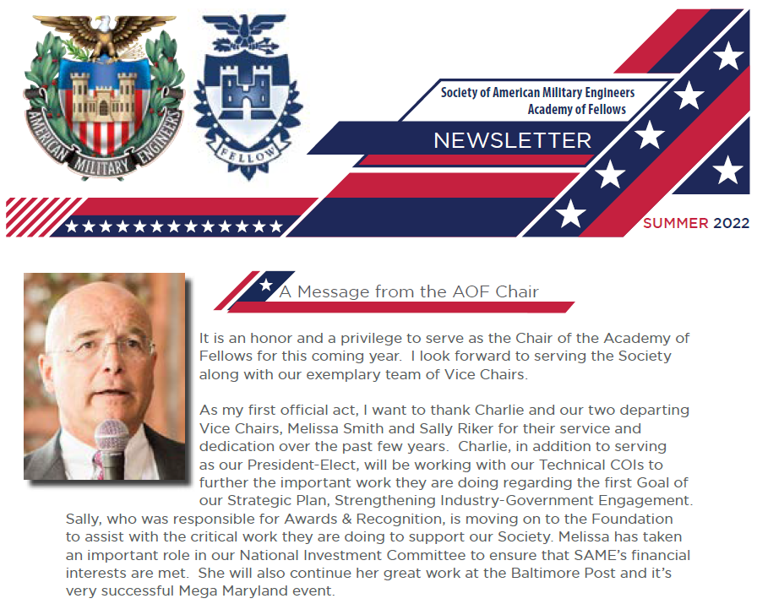
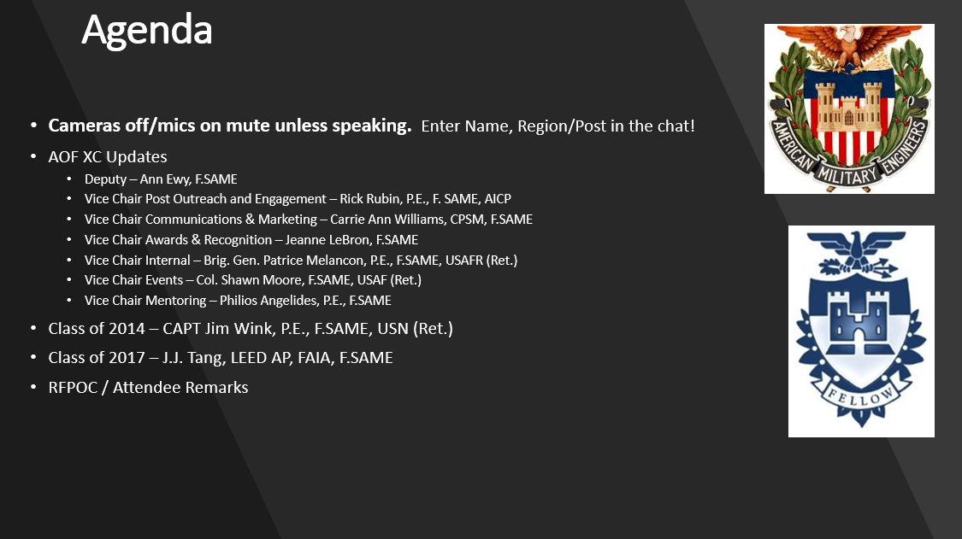
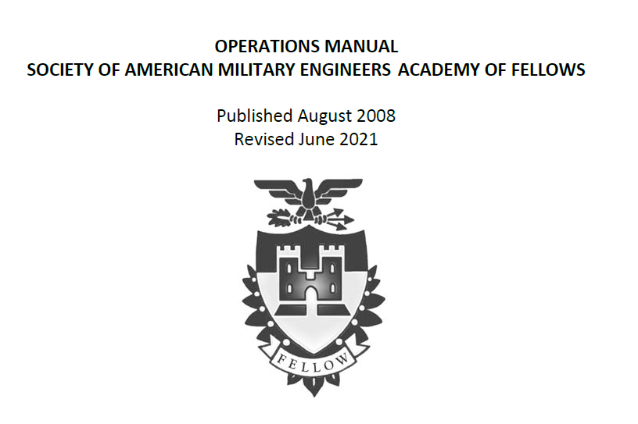
What else are we doing (continued)?
Blocking & Tackling
  Bi-weekly calls to track progress – AOF XC
  Fellows Selection Underway – Patrice Melancon
  Revised Fellows Ops Manual – Ann Ewy
  YP/Fellows Fundraising Challenge – Carrie Ann Williams
  Fellows Class Leaders Fundraising Challenge – Cindy Lincicome
  Facilitating Enlisted COI Planning Session – John Hudson, Craig Clutts
  Robust Newsletter – Carrie Ann
  Bi-monthly AOF Townhalls & RFPOC Outreach – Rick Rubin
Proposed
  Develop a Fellows Social Media Connection Plan – Carrie Ann
  Use new EMS as a tool to assist with tracking & benchmarking – Kathy Off
  Increase the number of Active-Duty members & Fellows – Patrick Hogeboom
  Augment the existing Fellows Webinar with A “½ Way to Fellowship” program – “Fellows 101” – AOF XC
  Continuing to evaluate data collected from the Fellows survey – Pat Coullahan

Slide 64
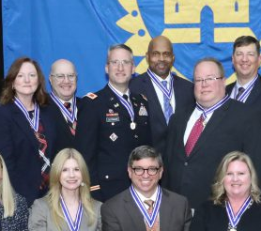
Elected Director Support
Pat Coullahan – Fellow Demographics
  Pulled all the information out of the survey
  Continuing to study it and provide more insights
Patrick Hogeboom – Uniformed Participation
  Assess the active-duty servicemember membership situation
  Reach out to current and past uniformed Post Presidents and other leaders on the value of participation
  Develop, refine, and execute action items
  Session at this SBC “Giving Back – SAME Participation on Active Duty”
Both Elected Directors have been active participants with the AOF XC which has provided them an invaluable inside look at AOF Operations.

Slide 65
Strategic Plan Assessments & Benchmarks (Technical COIs)
Charlie Perham, President-Elect

Slide 66
Tech COI Update
COI | Lead | Status
Environmental | Rick Wice | PFAS IGE, engaging, partnering
Joint Engineering Contingency Operations | James Romasz | Warfighter Seminar Success; JOEB taking on issues
Resilience | Al Romano | All ahead full
Small Business | Sally Clark | All ahead full
Facility Asset Management | Lisa Cooley | FAM workshop rolling into JETC
Architectural Practice | Cathy Otis | Emerging IGE issue
Energy & Sustainability | Norm Campbell | Work to be done
International | Charysse Knotts | Sunset

Slide 67
Strategic Plan Assessments & Benchmarks (Human Capital COIs)
Sharon Krock, Vice President

Slide 68
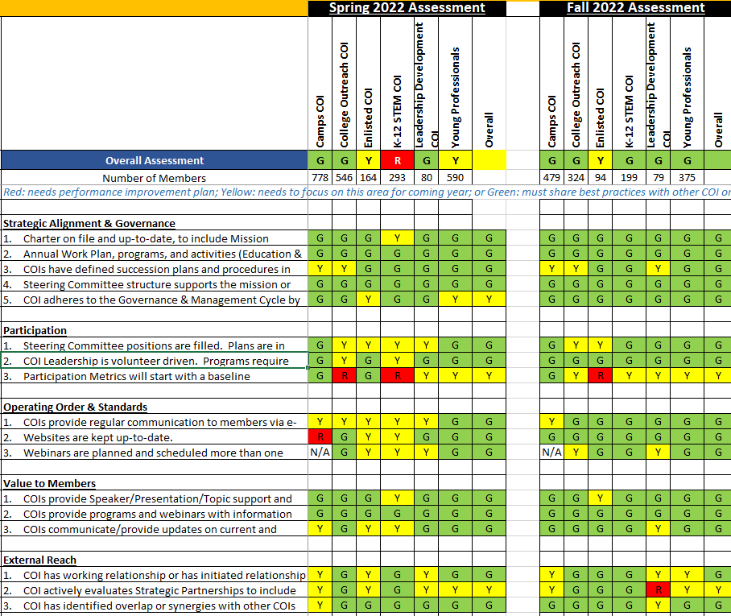
Human Capital COI
Assessments
Database/
Community Hub
Communication

Slide 69
National Camps Program
Memorandum of Agreement between SAME and each service that hosts a camp
Program Manual outlining procedures and timelines
Succession Planning

Slide 70
Strategic Plan Assessments & Benchmarks (RVPs & Membership)
Mike Darrow, Vice President

Slide 71
RVP and Membership Update
What is a post
Number of posts
Key actions since May BOD
  Post Closures
  RVP Post Assessments
Data Summary of assessments
  Overall trends – key common themes from the RVP assessments
  Strongest Posts - mostly green in all areas
  Posts that need help and attention
  Tools to help
    Leverage the COIS – speakers, expertise
    National Office
    Other RVPs - sharing of best practices at monthly meetings
Membership COI Update
  Focus areas and Status
  DEI Update – Tools for You

Slide 72
Post Overview
Minimum Post Requirements: Leadership in place, succession plans, at least 10 individual and 3 corporate members.
Number of posts: 98
Post Closures (pending approval of consent agenda)
  Delmarva
  Capital Region

Slide 73
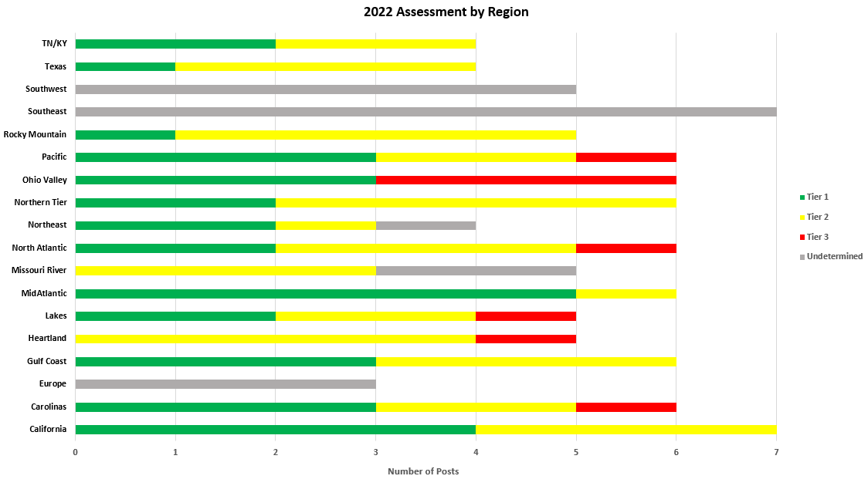
RVP 2022 Assessments

Slide 74
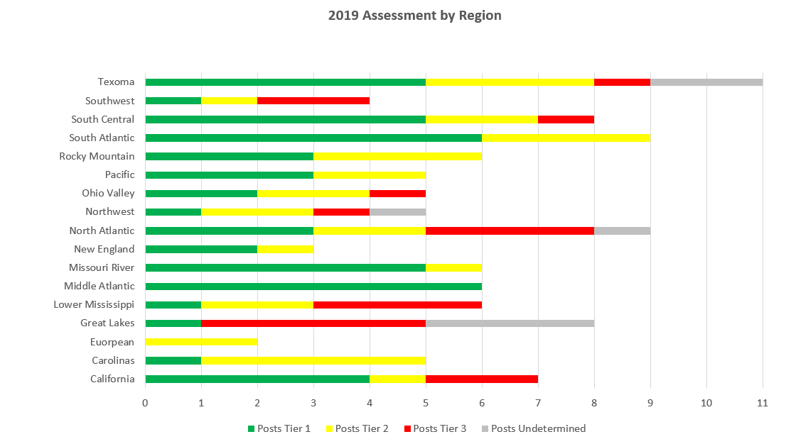
RVP Assessments

Slide 75
RVP Assessments – General Observations
Common Themes:
    Engagement/Attendance post-Covid – generally lagging – still a lot of hybrid events
    Succession Planning – Getting new leaders – a continued struggle
    Streamers updates – most lagging in input, still wait until the end of the year
    Goal 5: Preparing Vets for A/E/C industry – most Posts do not have activities
    Stronger posts are leveraging YPs and new faces on BODS
    Many are concerned about the new EMS and membership rules as they work to implement
    IGE is strong and most posts do best here
    Most successful posts are partnering with other regional post on events
    Many still struggle with government participation – USACE a challenge in some areas – not all
    Treasurer issues have created problems at some posts - late tax filing, consistent audits, etc.
    Post generally struggle with student chapters and keeping them consistently vibrant and functioning
    Many posts are holding annual planning meetings structured around strategic plan

Slide 76
RVP Assessments – General Observations
Strongest Posts –Overall Rating Green – Fully Functioning
    Oxnard – Ventura (California)
    Sacramento (California)
    Cape Fear Post (Carolinas)
    Charleston (Carolinas)
    Savannah (Carolinas)
    Ft Worth Post (Texas)
    Houston (Texas)
    San Antonio (Texas)
    Nashville (TN/KY)
    Minneapolis-St. Paul (Lakes)
    Rock Island (Lakes)
    Guam (Pacific)
    Anchorage (Pacific)
    Honolulu (Pacific)
    Hampton Roads (Mid-Atlantic)
    Virginia Peninsula (Mid-Atlantic)
    DC (Mid-Atlantic)
    Central Virginia (Mid-Atlantic)
    Northern Virginia (Mid-Atlantic)
    Denver (Rocky Mountain)
    Emerald Coast (Gulf Coast)
    Mobile (Gulf Coast)
    Panama City (Gulf Coast)
    Pittsburgh (Ohio Valley)
    Buffalo (Ohio Valley)
    Kitty Hawk (Ohio Valley)
    Portland (Northern Tier)
    Seattle (Northern Tier)
    Boston (Northeast)
    Piscataqua (Northeast)

Slide 77
RVP Assessments – General Observations
Struggling/Could Use Some Help –Overall Rating Red
    Huntington (Ohio Valley)
    Cincinnati (Ohio Valley)
    Detroit (Ohio Valley)
    Coastal Carolina (Carolinas)
    Illini (Lakes)
    Memphis (Heartland)
    Chesapeake (North Atlantic)
    Korea (Pacific)
    Fort Drum (Northeast)
General Challenges
  Limited member engagement
  Limited programs presented, only do one thing
  BODs are small, have gaps
  Government engagement- specifically USACE - need to provide a value proposition
  Proactive communications and meeting announcements

Slide 78
Organization Structure
Vice Chair, Tools & Resources: Joe DiMisa
Chair-elect, Strategic Direction: Bobbi Jo Lang
Vice Chair, Military & Government Engagement: Lee Ann Zelesnikar
Vice Chairs, Diversity, Equity & Inclusion: Debra Crafter and Elaina Edwards
Immediate Past Chair, Michael Huffstetler, F.SAME
Elected Directors: Danielle Barner, John Davis
Staff Liaison: Jill Murphy
Progress and Outcomes – Summary
Work Plan Submitted September 2022 – Focus on three main topics
Membership COI
Execute the DEI Action Plan and DEI National Plan to fulfill DEI Executive Statement
Work with National Office to educate Posts on benefits and uses of the SAME EMS leading to more efficient and effective communications throughout SAME community
Develop a portfolio of communications to reinforce SAME’s impact to the nation across all segments of membership

Slide 79
Membership COI
Tools & Resources
  Introduction meeting with new chair and comments on work plan
  In Progress
    Small business benefits flyer
    Development of enlisted/guard/reserve guidebook to instruct how post member chairs can reach to these groups
    Tools Subcommittee to get EMS trained
Strategic Direction
  In Progress
    Develop communications plan for:
      rebranding Sustaining Memberships
      strengthening the Membership POC Community
      developing a branding and communication strategy for membership as a whole

Slide 80
Membership COI
Military & Government Engagement
  In progress
    developing a list of certified mentors for IGE events and adding information on how to leverage IGE to build membership
    working with members of the enlisted COI and Military/Government subcommittee to develop a list of perceived barriers and their solutions to encourage government membership
Diversity, Equity & Inclusion
  In Progress
    Small business benefits flyer
    Development of enlisted/guard/reserve guidebook to instruct how post member chairs can reach to these groups

Slide 81
Membership COI
What’s Next - Diversity, Equity & Inclusion
  DEI Training session - PLW 2022
    DEI PowerPoint Training Presentation on “Cultivating A Sense of Belonging” is posted on PLW 2022 web page. A video of the aforementioned training was recorded as part of the training bundle. *Content will be posted to the PLW web page as well as the National Office continues with content migration into its new system
  DEI Communications - PLW Reference Guide
    DEI Commitment Statement and DEI National Plan have been incorporated into the document referenced above (pages 11 -14)
  DEI Toolkit Development:
    2 PowerPoint Micro Trainings have been created:
      “Fostering an Inclusive Climate”
      “Cultural Competency”
    *Content will be posted to the web page as the National Office continues with content migration into its new system
  SAME Bylaws 2022 - DEI
      DEI Mission Statement was approved and incorporated into the bylaws under Article XI: General Policy and Procedure (Item 3 – pages 8-9)

Slide 82
Consent Agenda Approved
Foundation Bylaws Updates 31/31
DelMarVa Post Closure 31/31
NY Capital Region Post Closure 31/31
International COI Sunset 31/31
BOD Meeting Minutes May 2022 31/31
XC Meeting Minutes August 2022 31/31
Foundation Meeting Minutes May 2022 31/31
Foundation Meeting Minutes June 2022 31/31

Slide 83
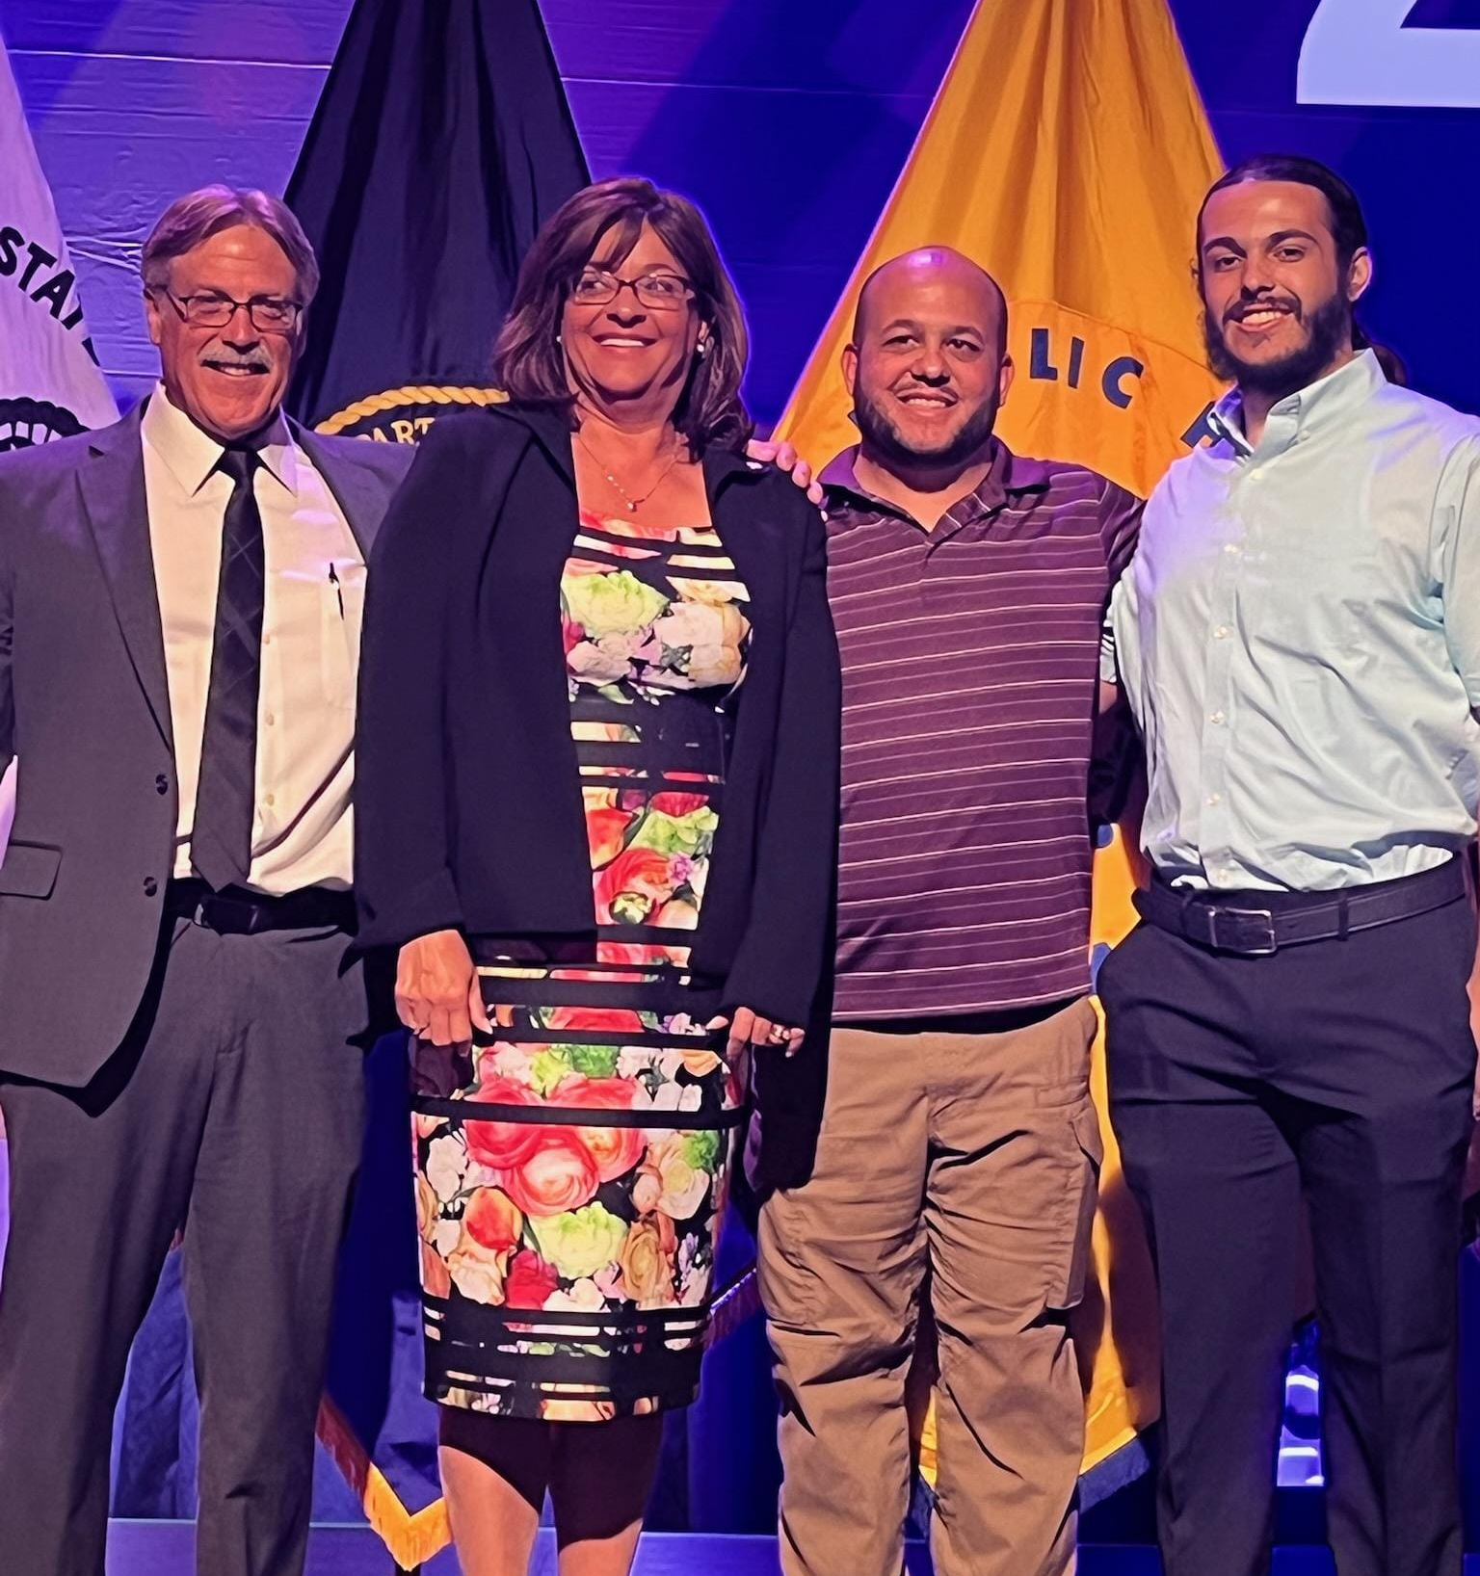
President’s Closing Remarks
Cindy Lincicome

Slide 84
Booth Assignments
You should have an envelope with your assignments and questions.
Visit your booths and NETWORK!
Return the index cards to the SAME Booth.
Don’t leave without getting your drink ticket!
Foundation Board & Volunteers, as well as many Fellow volunteers are assisting the board this year due to the volume of booths.

Slide 85
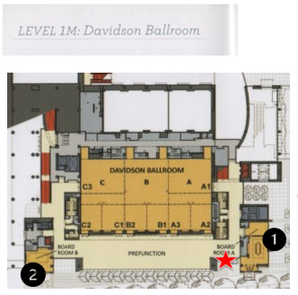
President’s Reception
Davidson Ballroom Foyer, 5:30 pm

